Slide 1
Let History Ring!
old Tolland County Court house
Cupola Restoration Program

Slide 2
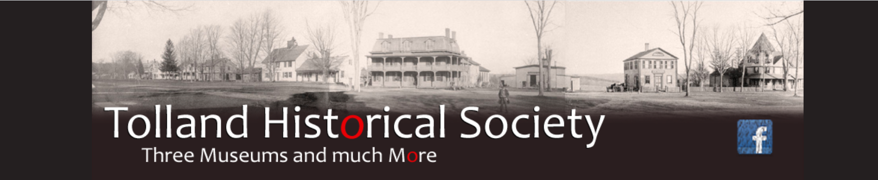
The Cupola on
our beloved Court House is
in need of repair!
Photo by Tom Calabrese

Slide 3
TOLLAND COUNTY AND
THE COURT HOUSE -
A SHORT HISTORY

Slide 4
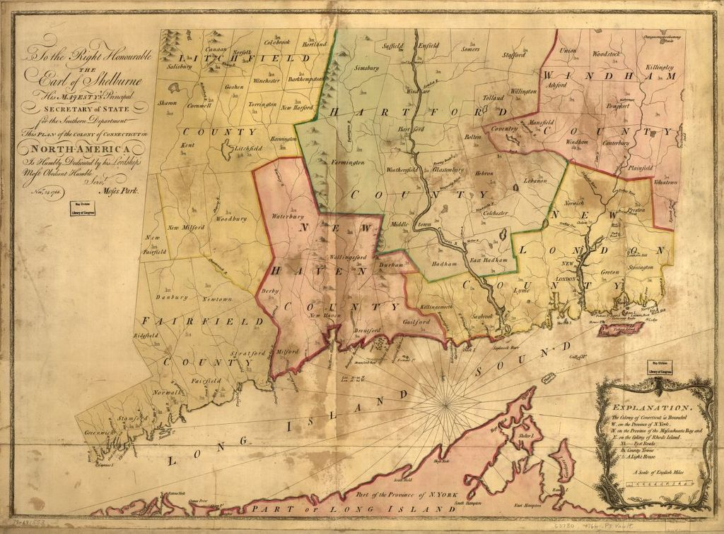
THE COUNTIES OF CONNECTICUT: COLONY AND STATE
County government in the Connecticut Colony originated in 1666, shortly after the original Hartford and New Haven colonies combined. Each of those became a county. Fairfield and New London counties were later divisions from the originals. Windham and Litchfield came still later, and Tolland and Middlesex not until after independence, in 1785. Area towns were part of Hartford and Windham counties and were separated for the new Tolland County with Tolland as its seat. The total county population in 1790 was 13,106.

Slide 5
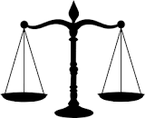
THE FUNCTION OF THE COUNTIES
Connecticut counties had more limited functions than those of most states and were responsible only for providing suitable facilities for courts and jails, the operation of jails and children's homes, agricultural extension services, granting liquor licenses, the inspection of weights and measures and a few other duties. Other governmental functions were the responsibility of the towns.
There is no longer any county government in Connecticut. The functions of the county, except for the Sheriffs Departments, were abolished in 1960, when the Tolland jail was transferred to the state. The sheriffs followed in 2000, and the county names remain only as designated court and extension service districts.

Slide 6
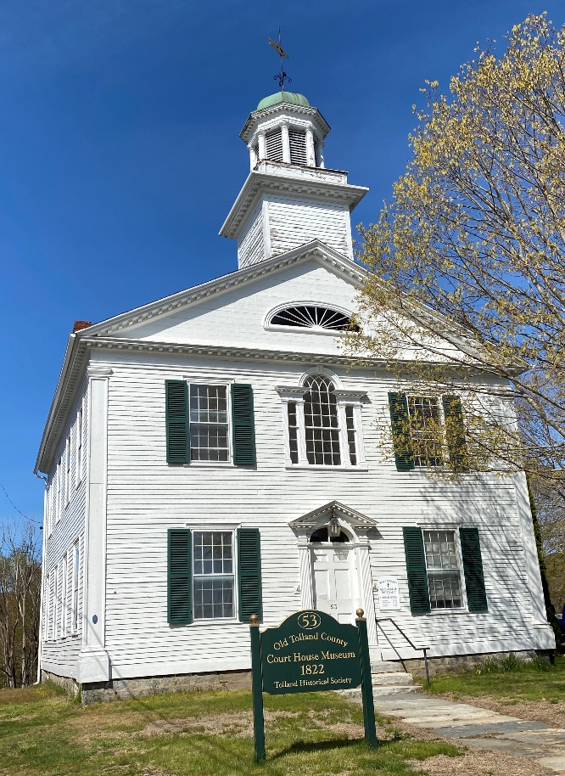
THE REPLACEMENT WAS BUILT IN 1822
Early civic buildings are rare in Connecticut, and this beautiful 1822 courthouse has been called one of the five most important remaining examples. It replaced an earlier building built in 1785 to satisfy the requirement of the state that the town must provide a courthouse and “gaol” in order to be designated as the Tolland County Seat.
All courts in Tolland County were held here until about 1890, when they relocated to the new Memorial Building in Rockville.

Slide 7
LET HISTORY RING!
DESCRIPTION OF OUR 1822 COURT HOUSE
Built on a tiny lot purchased from Calvin Willey, a lawyer and later a U.S. Senator this building, in a style transitional from Georgian to Federal, has a beautiful, original Palladian window above the pedimented and pilastered front door, and pilasters at the front corners. The front gable has dentil molding on the upper pediment.
The cupola, which repeats the dentil molding, denotes that the building is a civic building rather than a church. The weathervane, a stylized fish carved of wood and covered with gold leaf, has been replaced at least twice in the 20th Century. The large, heavy front door is topped by a rather crude replacement of the original fan window.

Slide 8
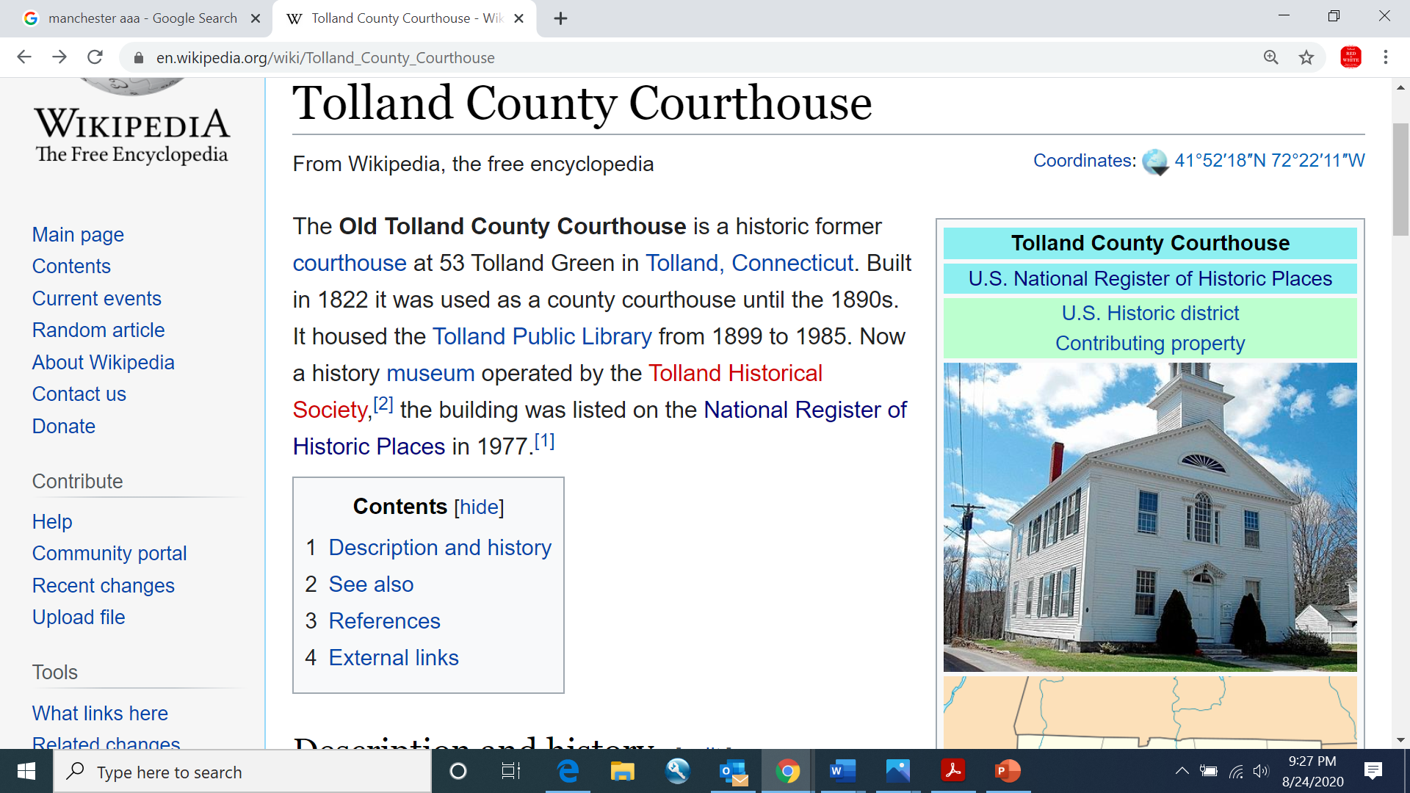
THE TOLLAND GREEN IN THE 1800s
Many of the homes along the green were built In the early 1800s, some occupied by lawyers who moved to town to be near the court house and some by doctors and the clergymen of the Congregational Church and two new churches. There was at least one store in operation and often more than one. Although Shepard's Tavern went out of business after the proprietor's death, there were two flourishing taverns or hotels. A more attractive and refined court house was desired; one befitting the town's increasing visibility and prestige as the County Seat. Local architects Harry Cogswell and Abner Davidson designed the new building, and William Cogswell, a local carpenter and father of the architect, was the builder. The cost was paid by a tax on all the towns in the county.

Slide 9
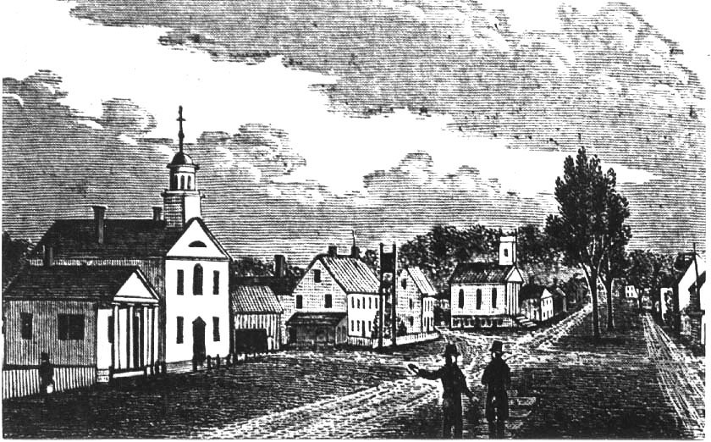
LET HISTORY RING!
In 1898, some of the woman of the community determined to create a public library, holding a meeting in the Agard parlor at the house now 76 Tolland Green. Emma
Hicks Downing of Springfield, a sister of Minnie and Ratcliffe Hicks, arranged for a library organizer from the state to speak. The meeting was attended by the Hicks
sisters, their niece Elizabeth Hicks, two Mrs. Agards and the Agard daughters and most of the ladies whose families had influence in town.
The library was moved to the newly renovated Hicks Municipal Center in 1985.
The building was given to the Historical Society by the Tolland Public Library Association in 2001, becoming the Society’s third museum.

Slide 10
DISCOVERY OF DAMAGE
In 2019, the Tolland Historical Society Building Committee members investigated some water damage. Issues with the Cupola were identified and discussed with the Tolland Historical Society Board of Directors.
The Tolland Historical Society the Board approved monies to hire an engineer to review structure and assess damage. The board approved researching grant options and started to outline a fundraising project

Slide 11
Estimated Expected Cost of Restoration: $200,000.
ANNOUNCEMENT
The Historical Society Announces A Slogan Contest And Describes The Issues With The Court House in January 2020
Tolland student Kate Reinard has donated a lovely drawing of the cupola for us to use during the fundraising drive.
An anonymous Society member won our slogan contest with ‘Let History Ring!’

Slide 12
Complexity of The Restoration
Our Engineering firm, Cirrus Structural ENGINEERING,
report On the damage that can be seen.
Once work begins, we may discover other required repairs.

Slide 13
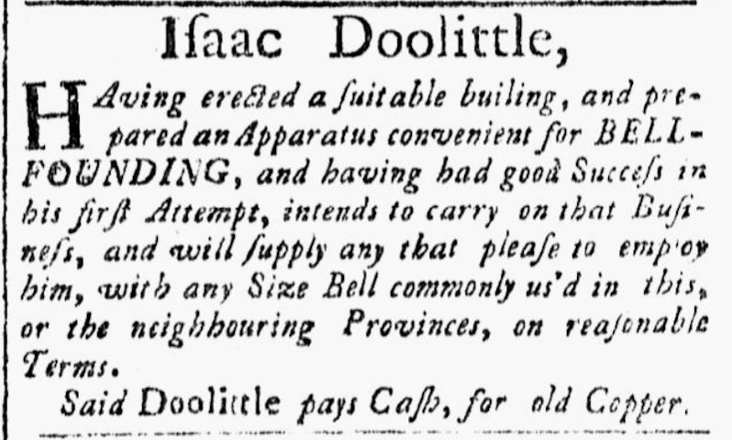
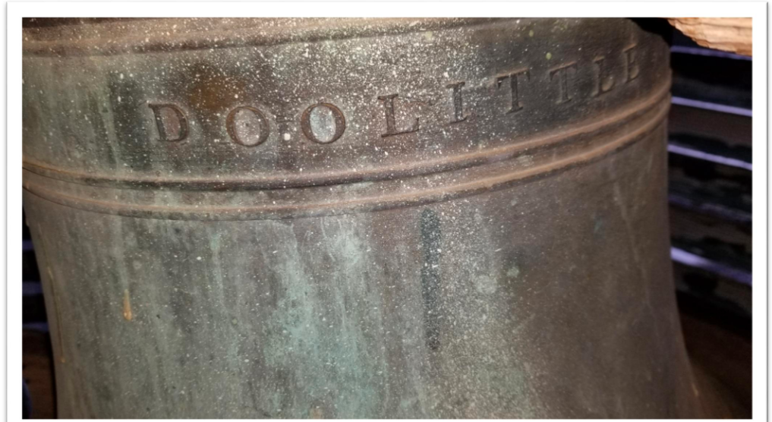
RESTORING THE BELL
The scope of work includes restoring the interior structure that cradles the bell as well as repairing the bell so that it can RING again.

Slide 14
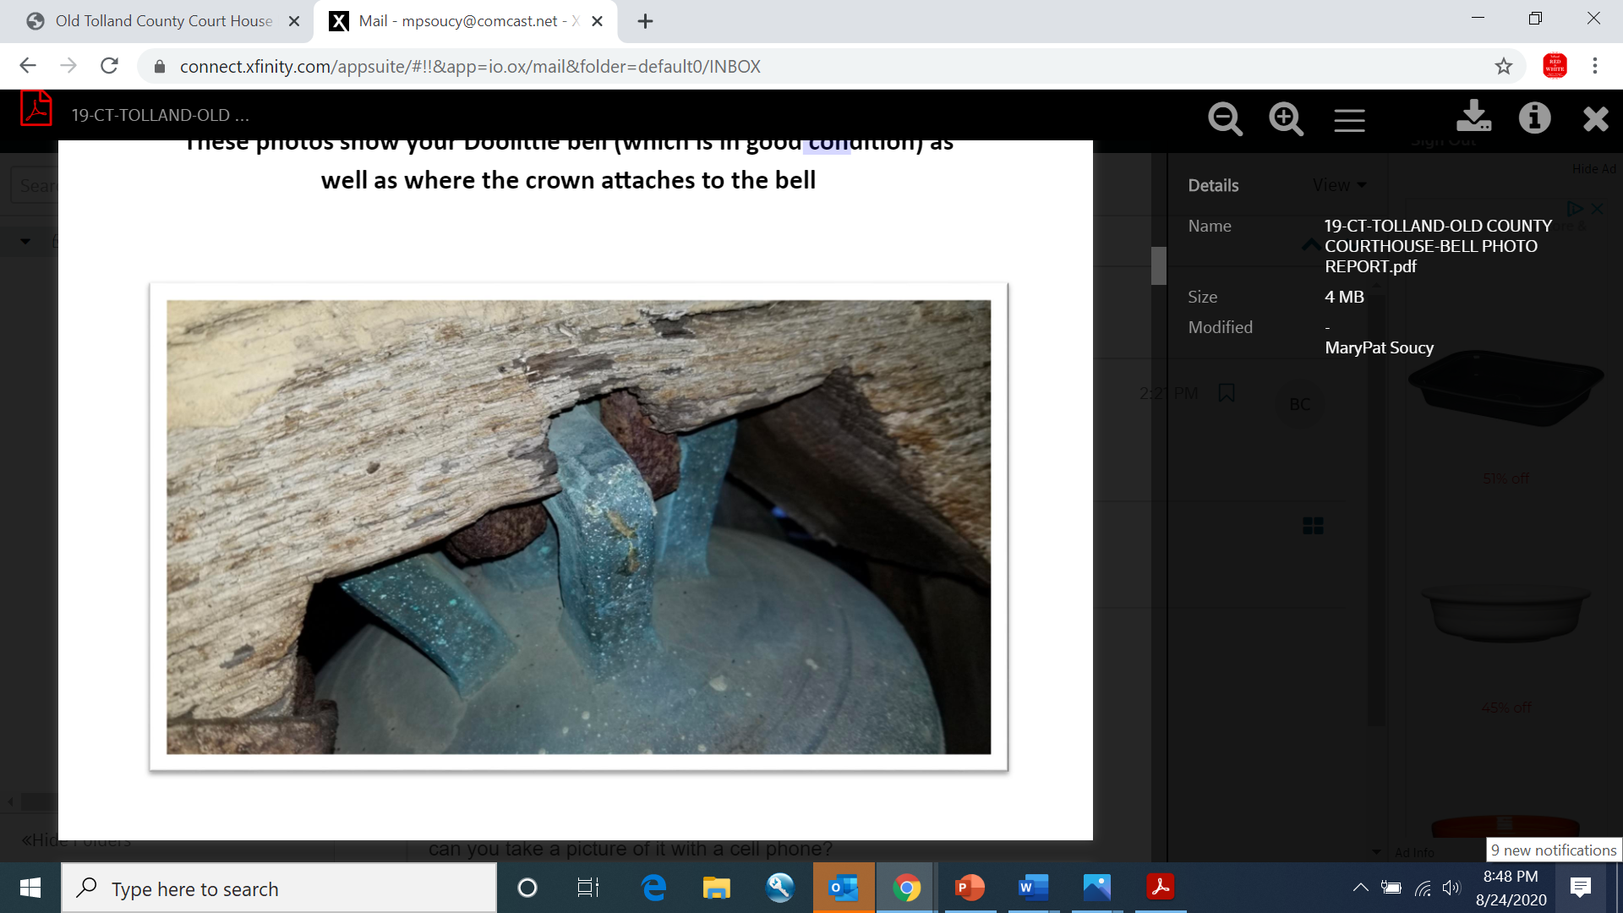
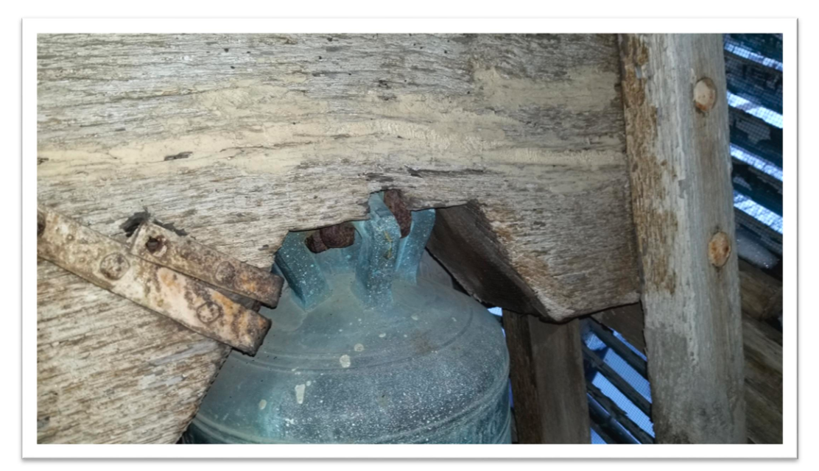
RESTORING THE BELL
The existing wood yoke is dried out and showing signs of cracks and deterioration. The yoke shall be replaced with the same materials as part of our project. The bronze crown on the bell appears to be in good condition.

Slide 15
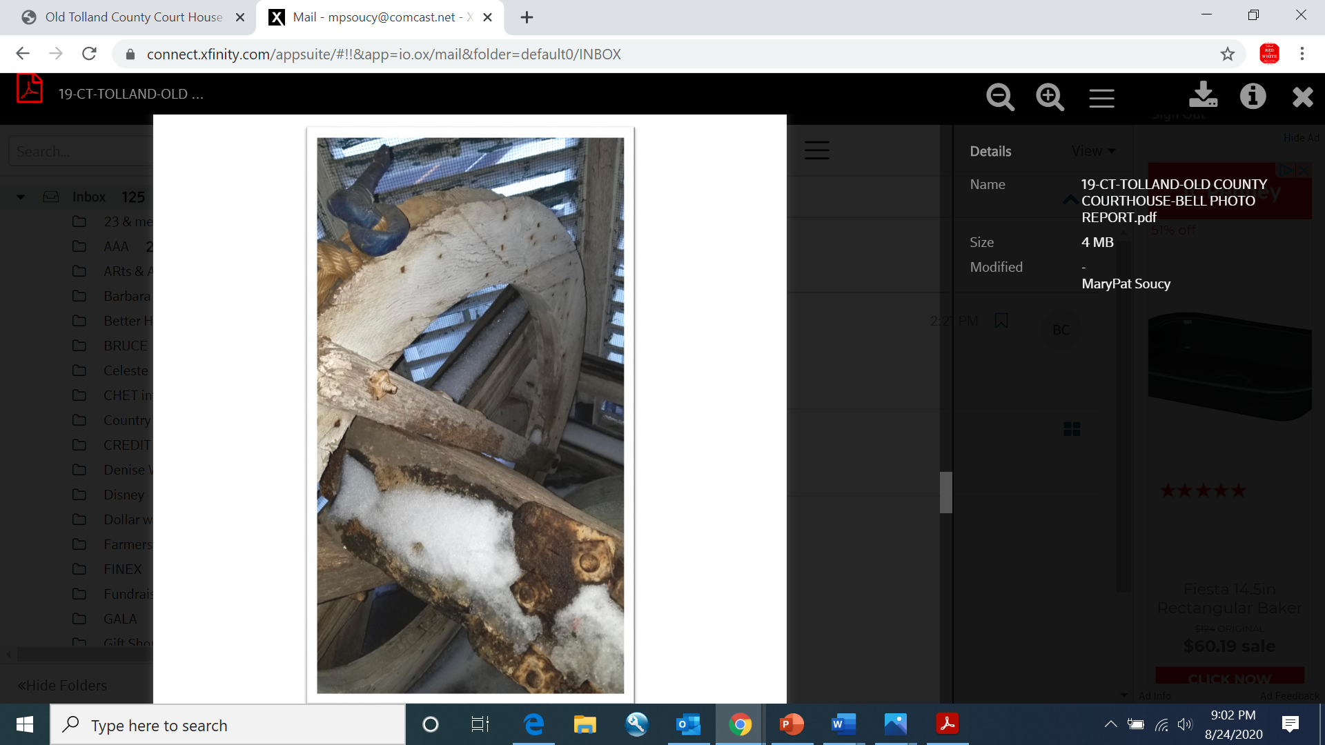
RESTORING THE WHEEL
The old wooden wheel is in poor condition and may also be original.
Engineers have recommend replacing the wheel, with a standard steel wheel, however, a wooden wheel is an option.
Photos by Carl Kresser of Kresser Woodworking

Slide 16
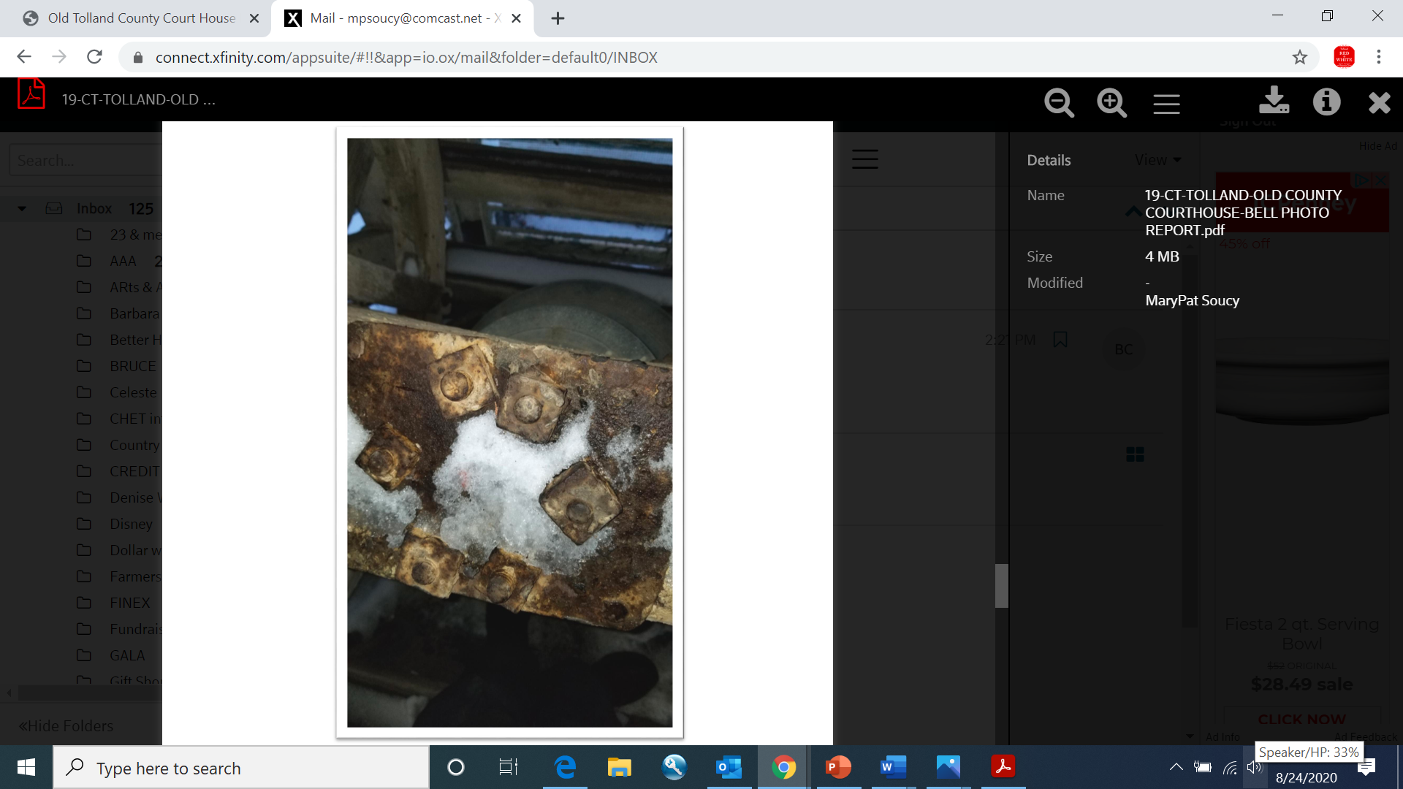
RESTORING THE YOKE
The old head bolts securing the bell to the yoke appear to be original and should be replaced.

Slide 17
RESTORING THE BELL TOWER
We need to restore and replace some interior and exterior parts of the bell tower.
Picture of the bell tower up to the cupola and bell.

Slide 18
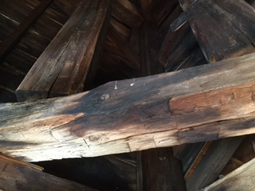
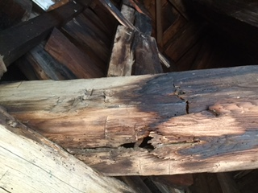
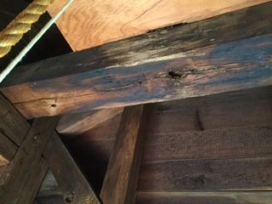
RESTORING THE COURT HOUSE
Damaged support beams.

Slide 19
The Tolland Historical Society is undertaking a major fundraising drive to restore the bell tower and cupola on the 1822 Old Tolland County Court House Museum.

Slide 20
OCTOBER 2020
Our community is enhanced by our museums and our rich history. Given the current pandemic, fundraising was put on hold. Now is the time to begin the process of rebuilding this great treasure.
Fundraising will continue until we can guarantee enough funds to repair the court house.

Slide 21
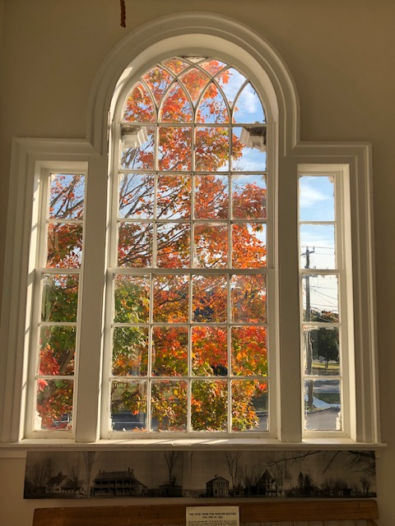
THE COURT HOUSE TODAY
You're supporting so much more than a renovation project. Your support for the restoration of the cupola and bell will help ring in the next century of life for this vital, contributing structure in the center of our Green in the heart of our community.
Today this beautiful building with its Palladian window still graces the center of our Green.
Thank you!

Slide 22
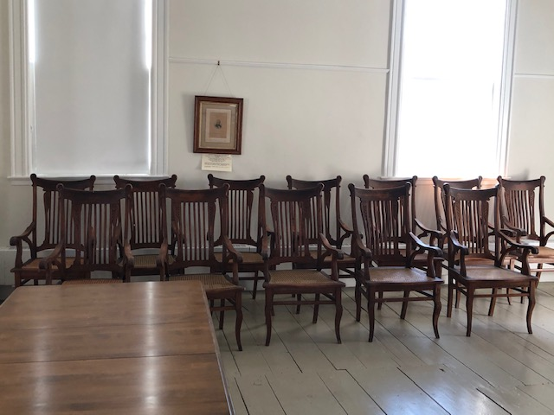
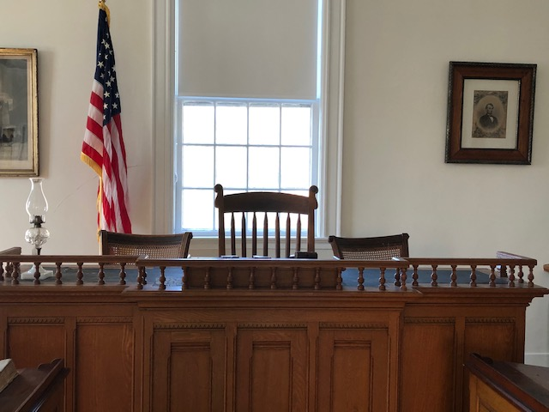
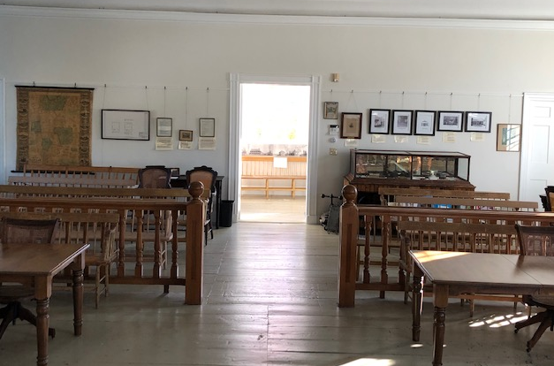
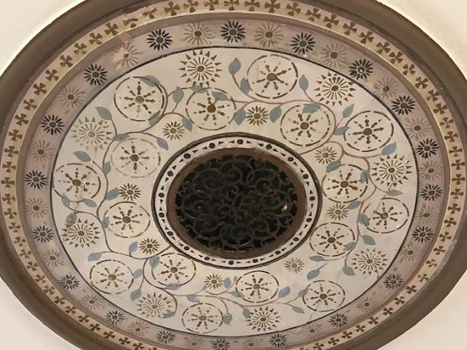
THE COURT HOUSE TODAY
Though the courts have moved to Rockville, activity remains within these walls. The second floor still contains a completely restored 19th-century courtroom.

Slide 23
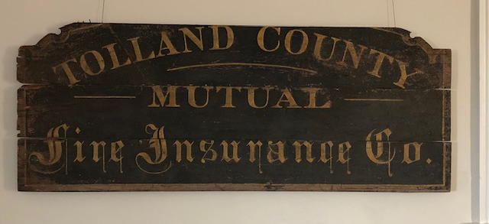
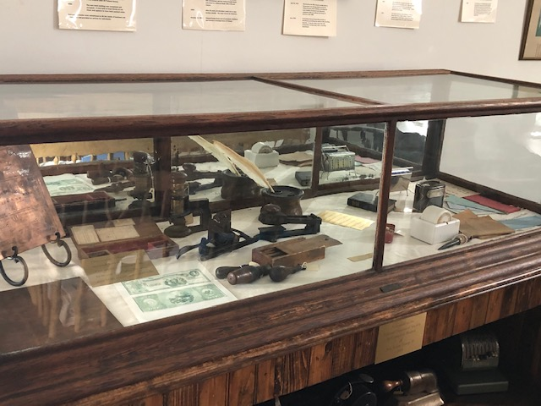
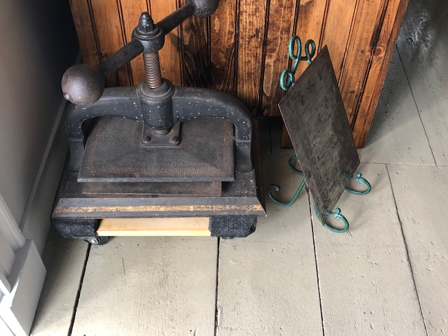
THE COURT HOUSE TODAY
Displays from the court and neighboring insurance and banking businesses can be found around the room.
Seasonal displays of interest to Tolland County residents cycle through this space.
Curriculum-based programs for school children of all ages, including mock trials, are offered.
The Tolland County Bar Association holds events here.
Filmmakers from Connecticut and NYC use our facilities.
The society museums collaborate with the Smithsonian Magazine Day, CT Open House Day and Blue Star Military Families Program.

Slide 24
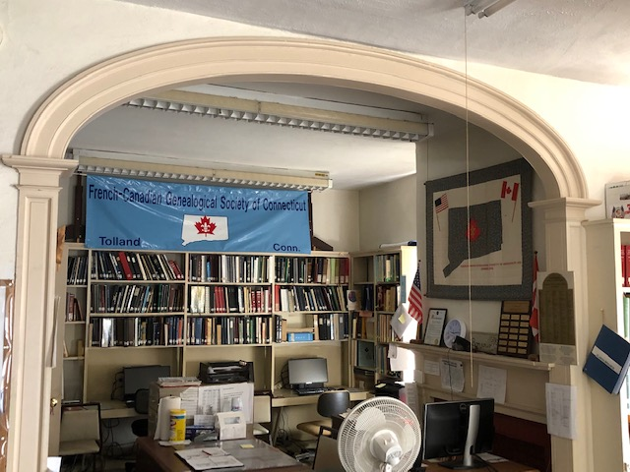
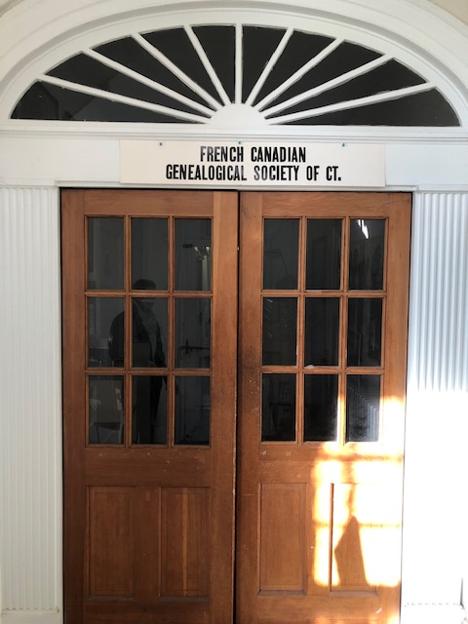
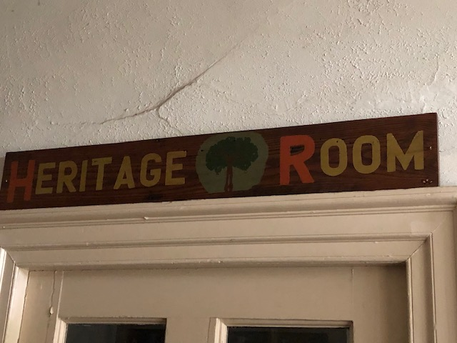
THE COURT HOUSE TODAY
The first floor is home to the French Canadian Genealogical Society of CT Research Center and Library.

Slide 25
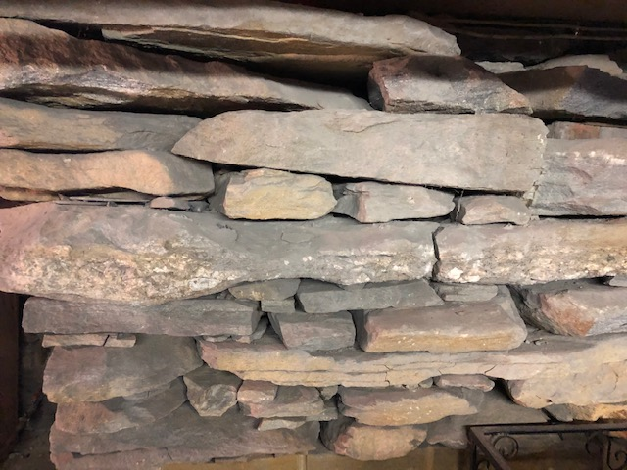
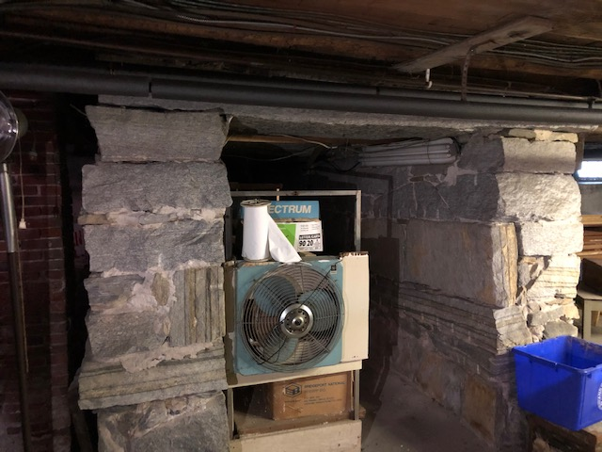
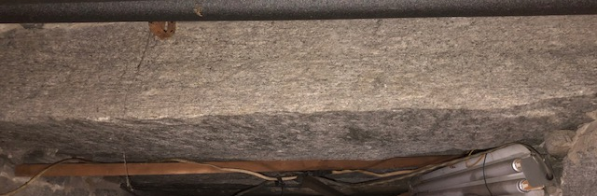
THE COURT HOUSE TODAY
Two hundred years ago a new court house was built upon this solid foundation.
It was two stories high with wide board floors, abandoning the earthen floors of the former structure situated on the Green. It was crowned with a domed cupola to establish its significance as a civic structure in the center of the town green, at the crossroads between New York and Boston and Springfield and the coast. This was significant to a new and growing county.

Slide 26
HOW CAN YOU HELP?
GIVE! Any little bit helps. Donations are tax-deductible.
GET INVOLVED! Volunteer for the historical society and become a member.
CARE! Support your community by caring about our history!
BEYOND! Further our cause by talking with residents and businesses to get the word out on this historic project.
Contact:
Find us on Facebook, http://tollandhistorical.org/
Tolland Historical Society, P.O. Box 107, Tolland, CT 06084

Slide 27
SUPPORT YOUR COMMUNITY
How to Donate:
Send check to Tolland Historical Society,
P.O. Box 107, Tolland, CT 06084.
(tax-deductible)
Volunteer: Contact Historical Society President Kathy Bach at kwbach@gmail.com.
Support: Court House merchandise can be purchased at the Old Tolland County Jail Museum or the Tolland Red and White at 46 Tolland Green.

Slide 28
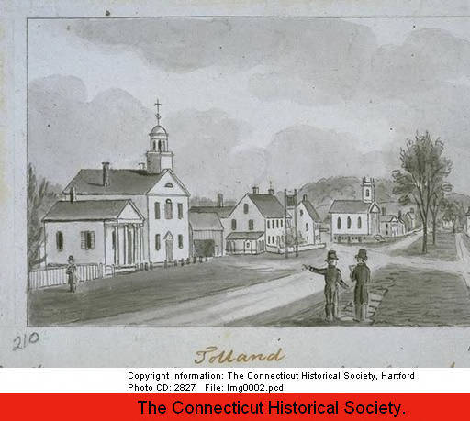
Our forefathers built this town. It’s up to us to preserve it. Let’s invest in the future. Just as they did.

Slide 29
Thank you to Tolland Historical Society Board
Governing Board Officers:
President Kathy Bach
Vice President Celeste Senechal
Secretary Kate Farrish
Treasurer Katie Fratoni
Deputy Treasurer Al Fratoni
Directors:
Benton Museum Gail White Usher
Courthouse Museum Board
Jail Museum Kathy Bach
Archives Barbara Cook
Sandy Gallup
Membership Cathy Wilcox
Programs Celeste Senechal
Mary-Pat Soucy
Fundraising Mary-Pat Soucy
Operating Board Committee Chairs:
Public Relations Kate Farrish
Antiques Show Mary-Pat Soucy
Dr. Sharron Laplante
Sponsors/Ads Jaden Delgobbo
Endowments Peter Brown
Retail Sales Wendy Wallace
Publications Board
Publicity Kate Farrish
Buildings /Grounds Dave Geissler
Media Perne Maynard
Collections Allison Free
At Large Dr. Sharron Laplante
At Large Ni-Ni Reinard
Technology Ben Free

